Slide 1
Chapter#4 Threads & Concurrency

Slide 2
MCQs
What is the primary purpose of the "Kernel Mode" in an operating system?
a: To execute user-level applications
b: To display user instructions
c: To run system-level tasks and interrupt handlers
d: To manage hardware resources
In a context switch, which of the following is NOT typically saved and restored?
a: Program counter (PC)
b: Stack pointer (SP)
c: General-purpose registers
d: Cache memory
Notes:
Source:-Virtual Labs

Slide 3
MCQs
What is the role of the Process Control Block (PCB) in an operating system?
a: To display user instructions
b: To manage hardware resources
c: To store details of a process during its execution
d: To execute interrupt handlers
Which component of a CPU is responsible for fetching and decoding instructions?
a: Control unit
b: Arithmetic logic unit (ALU)
c: Memory Unit
d: Input/Output Unit (IOU)

Slide 4
MCQs
What is the purpose of a timer interrupt in a multitasking operating system?
a: To synchronize processes
b: To initiate a context switch
c: To handle user input
d: To allocate memory
Which of the following is NOT typically a part of the Process Control Block (PCB)?
a: Process ID
b: Program counter (PC)
c: Cache memory
d: Register values
What is the primary purpose of a context switch in an operating system?
a: To save power
b: To restart the computer
c: To allow multitasking and switch between processes
d: To update system documentation

Slide 5
Correct Answers
C
In the kernel mode, the operating system manages system-level tasks such as memory management, device drivers, and interrupt handling. For example, it handles hardware interrupts generated by devices like disk drives or network cards
D
During a context switch, the CPU typically saves and restores the program counter (PC), stack pointer (SP), and general-purpose registers. Cache memory is not saved and restored because it is part of the CPU's internal architecture and not directly related to the process state.
C
the PCB stores details of a process during its execution. For example, it stores the process state, such as the program counter (PC), stack pointer (SP), and general-purpose registers.

Slide 6
Correct Answers
A
The control unit is responsible for fetching and decoding instructions.
B
A timer interrupt is used to enforce time-sharing among multiple processes in a multitasking operating system. When a timer interrupt occurs, the system can perform a context switch to allow another process to execute, ensuring fair CPU time allocation.
C
Simply, PCB does not store cache memory
C
A context switch is used to allow multitasking and switch between processes.

Slide 7
Questions !!
Describe the actions taken by the kernel to context-switch between two processes.
Briefly describe main differences between a process and a program.

Slide 8
Questions !!
Describe the actions taken by the kernel to context-switch between two processes.
In response to a clock interrupt, the OS saves the PC and user stack pointer of the currently executing process, and transfers control to the kernel clock interrupt handler.
The clock interrupt handler saves the rest of the registers, as well as other machine state, such as the state of the floating point registers, in the process PCB.

Slide 9
Questions !!
Describe the actions taken by the kernel to context-switch between two processes.
The OS invokes the scheduler to determine the next process to execute
The OS then retrieves the state of the next process from its PCB, and restoresthe registers. This restore operation takes the processor back to the state inwhich this process was previously interrupted, executing in user code withuser mode privileges.

Slide 10
Questions !!
Briefly describe main differences between a process and a program.
Program is a set of instructions stored on secondary memory like hard disk.
Process is usually defined as an instance of a running program, and consists of two components:
A kernel object--Process Control Block (PCB) that the operating system uses to manage the process. PCB is also where the system keeps statistical information about the process.
An address space that contains all the executable or DLL module's code and data. It also contains dynamic memory allocations such as thread stacks and heap allocations.

Slide 11
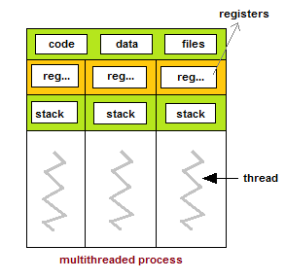
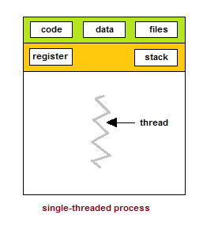
Threads
A thread is a light weight process.
A thread is a unit of execution within a process
A process has at least thread, called main thread.
It is not uncommon for a process to have multiple threads.
Each thread maintain it’s own stack

Slide 12
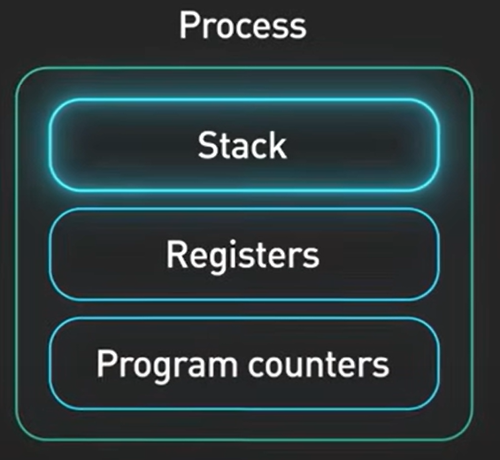
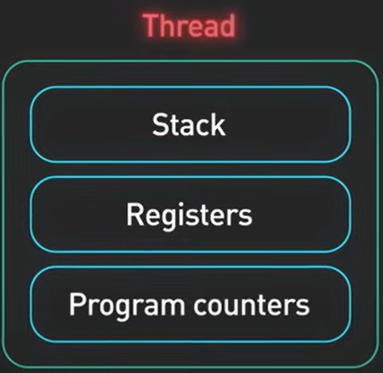

Slide 13
Threads
A thread is a basic unit of CPU utilization, it comprises ;
Thread ID
Program counter
Register set
Stack

Slide 14
How Multiple Threads Execute
Recall, Context Switching in Processes
Definition: Process context switching is the process of storing and restoring the state (context) of a CPU so that multiple processes can share a single CPU resource.
Implication: This process incurs overhead, slowing down execution.

Slide 15
How Multiple Threads Execute
Cost of Context Switching
Context switching between processes is resource-intensive.
Involves saving and loading program states, memory contents, etc.
Efficiency in Thread Execution
Threads share the same memory space, reducing overhead.
Context switching between threads is faster than between processes due to fewer resources involved.

Slide 16
How Multiple Threads Execute
In conclusion, Context switching, the process of saving the state of one process/thread and restoring another, is faster and lighter when switching between threads within the same process compared to switching between different processes because threads share memory, while processes have separate memory spaces.

Slide 17
Single Threaded and Multi Threaded Process
Many software packages that run on modern desktop PCs are multithreaded. An application typically is implemented as a separate process with several threads of control.
For example, a word processor ;
A thread for displaying graphics.
Another thread for responding to keystrokes from the user.
And third thread for performing spelling and grammar checking in the background.

Slide 18
Single Threaded Process

Slide 19
Multi Threaded Process

Slide 20
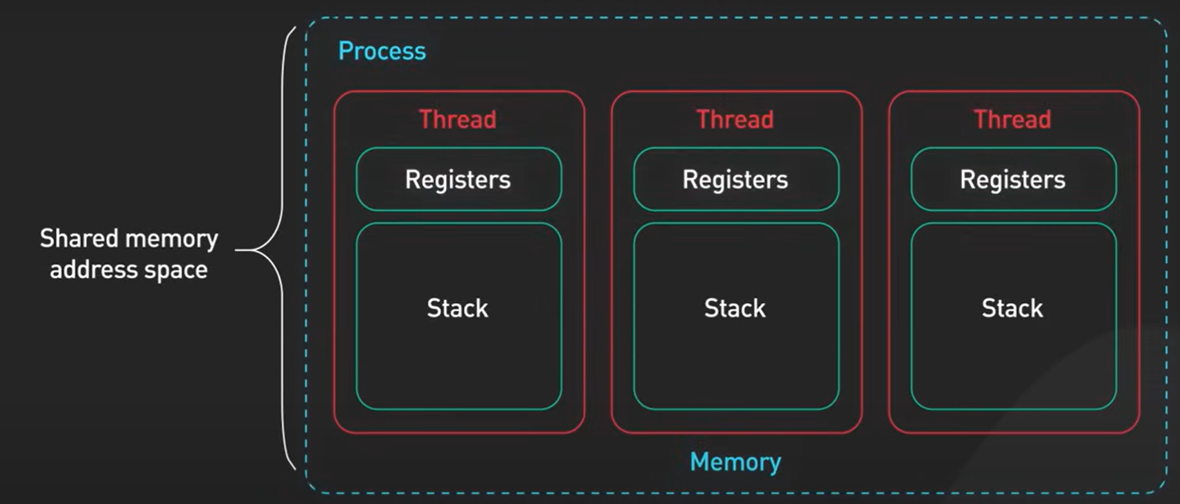

Slide 21
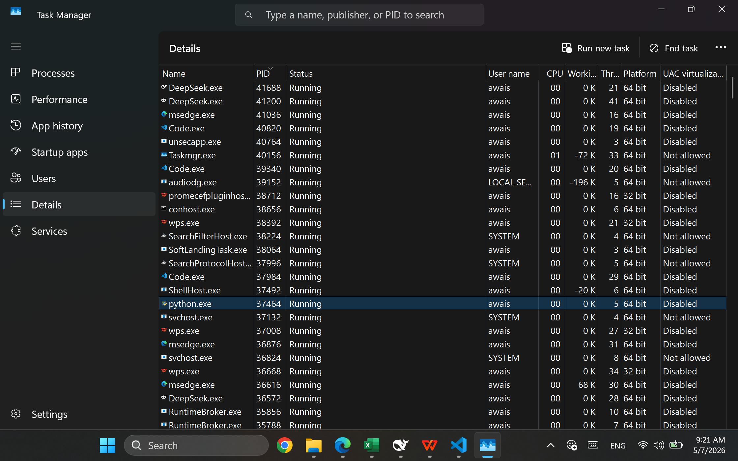
Python.exe (A process with five threads)

Slide 22
Why 5 threads?
import os print("Python process started. PID:", os.getpid())
time.sleep(60) # stay alive for 60 seconds
A simple Python script (with time.sleep(60)) may starts a main thread plus a few internal threads (e.g., garbage collector, memory manager, possibly thread management). So a baseline Python process often shows 4–6 threads. When you run multi‑threaded code, you’ll see the thread count increase.

Slide 23
When to Use which one?
Use single‑threading when:
The task is naturally sequential (e.g., command‑line tools that process one file after another).
Simplicity is more important than performance.
The application does not benefit from concurrency (e.g., a simple calculator).
We want to avoid synchronisation bugs entirely.
Use multi‑threading when:
We need to keep the UI responsive (e.g., a word processor: typing thread while spell‑check runs).
We want to utilise multiple CPU cores (e.g., video encoding, scientific computing).
The workload is I/O‑bound (e.g., web server handling many clients; threads can wait for I/O while others run).
We need to share data between tasks efficiently (e.g., producer‑consumer using shared buffer).

Slide 24
Examples
Application example | Threading Model
ls command | Single‑threaded
Microsoft Word | Multi‑threaded
Web browser (Chrome) | Multi‑process + multi‑threaded
Web server (Apache) | Multi‑threaded (or multi‑process)
Video player (VLC) | Multi‑threaded

Slide 25
Differences
Feature | Single‑Threaded | Multi‑Threaded
Number of threads | 1 | ≥ 2
Concurrency | No (only one task at a time) | Yes (tasks interleaved or parallel)
Parallelism on multi‑core | Not possible (only one core used) | Possible (threads can run on different cores)
Memory footprint | Smaller (one stack, one set of registers) | Larger (each thread needs its own stack and register context)

Slide 26
Differences
Fault tolerance | A crash kills the whole process | A crash in one thread may kill entire process (unless isolated)
Programming complexity | Simple (no synchronisation) | Complex (races, deadlocks, etc.)
Resource sharing | Not applicable (only one thread) | Threads share address space → fast communication
Blocking I/O impact | Entire process blocks | Only the blocked thread waits; others continue

Slide 27
Benefits of Multithreaded Programming
There are five major benefits of multithreaded programming.
Responsiveness.
Resource sharing
Economy
Scalability
Less communication overheads

Slide 28
Benefits of Multithreaded Programming
Responsiveness – Background tasks do not freeze the user interface.
Resource sharing – Threads share memory easily (no IPC overhead).
Economy – Creating a thread is cheaper than creating a process.
Scalability – Work can be split across multiple cores.
Throughput – Overlapping I/O and computation increases total work per second.

Slide 29
Disadvantages of Multithreaded Programming
Complexity – Requires synchronisation (mutexes, semaphores) to avoid race conditions.
Debugging difficulty – Heisenbugs (bugs that disappear when debugging) are common.
Overhead – Context switching between threads still costs CPU time.
Potential for deadlocks – Improper locking can freeze threads.
Crash vulnerability – One thread’s illegal memory access can crash the whole process.

Slide 30
Questions
Who decides which one to choose between two? OS itself, or we user?
Who Decides the Number of Threads?
Who Decides the Number of Processes?

Slide 31
Questions
Who decides which one to choose between two? OS itself, or we user?
The decision between single-threading and multi-threading (and which threading model to use) is made by the programmer (user) when designing the application. The operating system only provides the underlying mechanisms (system calls, thread libraries, scheduler). It does not “choose” for us.

Slide 32
Who decides What?
Decision | Made by | Explanation
Whether to use single‑threaded or multi‑threaded design | Programmer | Based on the problem: is it sequential? Does it need responsiveness or parallelism?
Which threading model to implement (many‑to‑one, one‑to‑one, etc.) | Programmer (or language runtime) | The programmer chooses a threading library (e.g., POSIX threads → one‑to‑one on Linux; Green threads → many‑to‑one). Some languages (Go, Erlang) have their own scheduler that implements a variant of many‑to‑many.
How threads are mapped to kernel threads | OS (fixed by design) | Once the programmer uses a particular library (e.g., pthreads on Linux), the OS follows its own model – you cannot change it at runtime. Linux uses one‑to‑one; older Solaris used many‑to‑many.
Which core runs which thread | OS Scheduler | The OS decides thread scheduling and core assignment, but the programmer can give hints (e.g., thread affinity).

Slide 33
Summary
Programmer is the architect: decides whether to build a single‑lane road (single-thread) or a multi‑lane highway (multi-thread).
OS is the traffic controller: manages how cars (instructions) flow on the lanes you built.
You (the programmer) choose the threading model and whether to go single or multi‑threaded. The OS only executes your choice and schedules the threads.

Slide 34
Questions
Who Decides the Number of Threads?
The programmer explicitly creates threads in code (e.g., pthread_create(), std::thread, fork() for processes).
The number of threads is design‑time choice:
Fixed thread pool size (e.g., 4 threads for a quad‑core CPU)
Dynamic: one thread per client in a server (e.g., web server creates a thread for each connection)
Threads can be created/destroyed at runtime based on workload.

Slide 35
Questions
Who Decides the Number of Processes?
The programmer and the user (by running programs) – but processes are often created dynamically.
Static processes: When you write code, you decide how many processes to start (e.g., fork() once gives 2 processes, fork() twice gives up to 4).
Dynamic processes: Many programs create processes on demand:
Web server forks a child per client.
Shell creates a new process for every command typed.
Browser spawns a new process per tab.

Slide 36
Who Decides the Number of Processes?
Examples:
A simple hello.c compiled and run → 1 process (the program itself).
A shell script that runs ls, grep, wc in a pipeline → 3 processes (one for each command).
Chrome browser: you open 5 tabs → might have 5 renderer processes + 1 browser process = 6 processes (plus extensions, GPU process, etc.).
Can we know the exact number in advance?
For a simple, deterministic program (no user input, no conditional forks) – yes, you can count the number of fork() calls.
For interactive applications (web servers, browsers, shells) – no, because the number depends on user actions (e.g., how many tabs you open, how many clients connect).

Slide 37
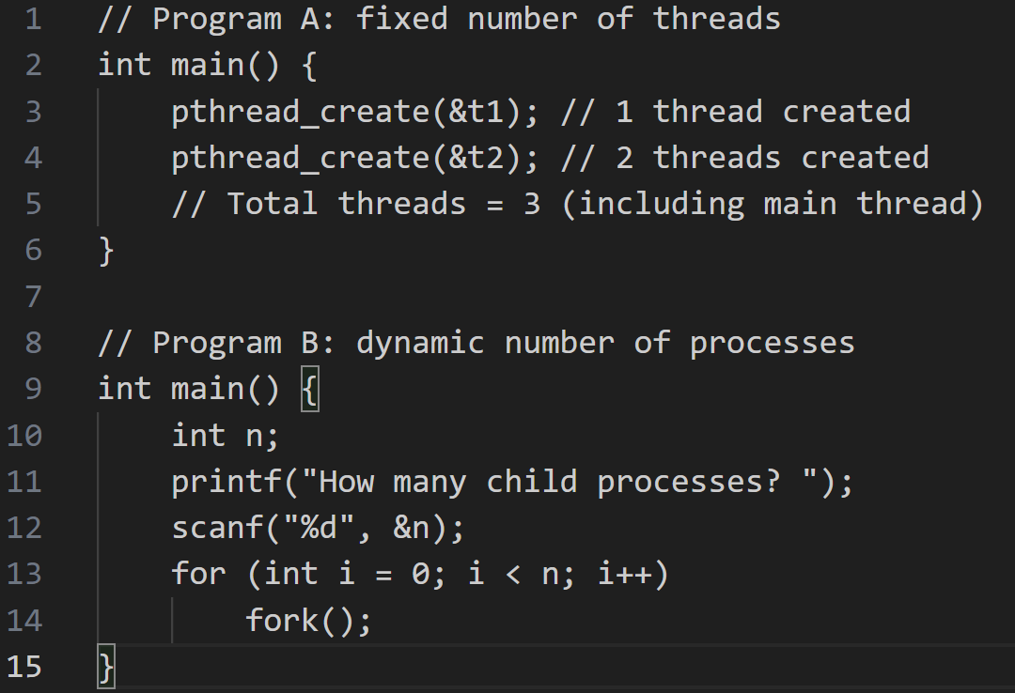
Example Program

Slide 38
Responsiveness
Multithreading increase the responsiveness to the user. Multithreading may allow a program to continue running even if part of it is blocked or is performing a lengthy operation.
For instance, a multithreaded web browser could allow user interaction in one thread while an image was being loaded in another thread.

Slide 39
Resource Sharing
Threads share the memory and the resources of the process to which they belong by default.
The benefit of sharing code and data is that it allows an application to have several different threads of activity within the same address space.

Slide 40
Economy
Allocating memory and resources for process creation is costly.
Thread share the resources of the process to which they belong, so it is more economical to create thread.
It is much more time consuming to create and manage process than thread.
For e.g Solaris, creating a process is about thirty times slower than is creating a thread.

Slide 41
Scalability
The benefits of multithreading can be greatly increased in a multiprocessor architecture, where threads may be running in parallel on different processors.
A single threaded process can only run on one processor, regardless how many are available.

Slide 42
Less Communication Overheads
Communicating between the threads of one process is simple because the threads share everything, address space.
So, data produced by one thread is immediately available to all the other threads.

Slide 43
Single Core and Multi Core System
A recent trend in system design has been to place multiple computing cores on a single chip, where each core appears as a separate processor to the operating system.
Multithreaded programming provides the mechanism for more efficient use of multi-cores and improved concurrency.

Slide 44
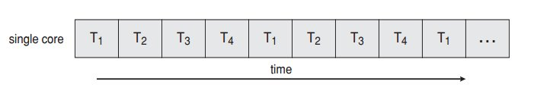
Thread Execution on Single Core System
Consider an application with four threads (T1, T2, T3 and T4). On a system with a single computing core, concurrency merely means that the execution of a threads will be interleaved over time, as the processing core is capable of executing only one thread at a time. As shown in figure below;

Slide 45
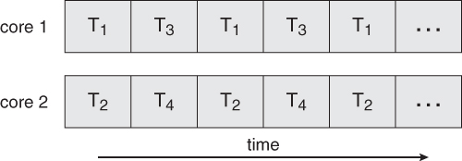
Thread Execution on Single Multiple Core System
On a system with multiple cores, however , concurrency means that the thread can run in parallel, as the system can assign a separate thread to each core.

Slide 46
Thread Library
A thread library provides the programmer with an Application programming interface (API) for creating and managing threads.
Thread library contain code for;
Creating and destroying threads.
Passing messages and data between threads
Scheduling thread executing
Saving and restoring thread contexts

Slide 47
Kernel Threads
Kernel threads exist within the context of a process and provide the operating system the means to address and execute smaller segments of the process.
It also enables programs to take advantage of capabilities provided by the hardware for concurrent and parallel processing.
Kernel threads are supported and managed directly by the operating system.

Slide 48
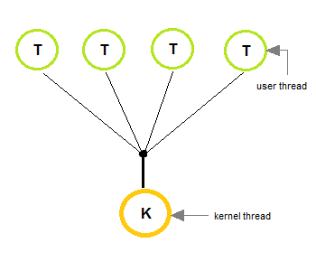
Multithreading Models (Many-To-One Model)
In many-to-one model, many user level threads are map to one kernel thread.
Thread management is done by the thread library in user space.
This model is efficient , but the entire process will block if a thread makes a blocking system call.
Only one thread can access the kernel at a time, multiple threads are unable to run in parallel on multiprocessors.

Slide 49
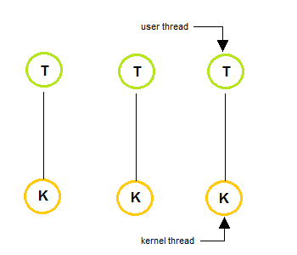
Multithreading Models (One-To-One Model)
In one-to-one model, each user thread map to kernel thread.
It provides more concurrency than many-to-one model by allowing another thread to run when a thread makes a blocking system call.
This model allows running multiple threads on multiprocessor system.

Slide 50
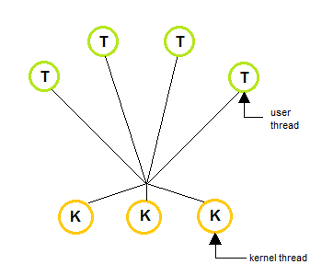
Multithreading Models (Many-To-Many Model)
The many-to-many multiplexes many user level threads to a smaller or equal number of kernel threads.
In many-to-many model, when a thread performs a blocking system call, the kernel can schedule another thread for execution.

Slide 51
Which Model is Best?
For general‑purpose OS (Linux, Windows) → One‑to‑one wins because it is simple, delivers true parallelism, and modern hardware can handle thousands of kernel threads efficiently.
For languages with lightweight concurrency (Go, Erlang) → A variant of many‑to‑many is used to create millions of “green” threads without exhausting OS resources.
Many‑to‑one is almost extinct due to the blocking problem and lack of parallelism.

Slide 52
Which Model is Best?
A web server that handles 1000 concurrent connections (mostly I/O bound) on a 16-core machine.
A real-time robot controller with 5 time‑critical tasks.
A legacy application that must be portable across many OS and cannot use native threads.

Slide 53
Conclusion
Number of threads is a programming decision – you choose it when you write code (though it can vary at runtime based on conditions).
Number of processes is also largely a programming choice, but many processes are created by user actions (opening an app, clicking a link, typing a command). Therefore, you often cannot predict the exact number of processes in a running system.
The OS does not decide these numbers for your application; it just enforces limits and schedules what you create.
In summary, the programmer decides maximum/typical numbers. The OS provides the mechanism and limits. The user’s behaviour determines actual numbers at runtime

